Slide 1

Ron Asis – Intuit Presentation
Who I am ? | Experience | Portfolio of my work | Business Case | End

Slide 2

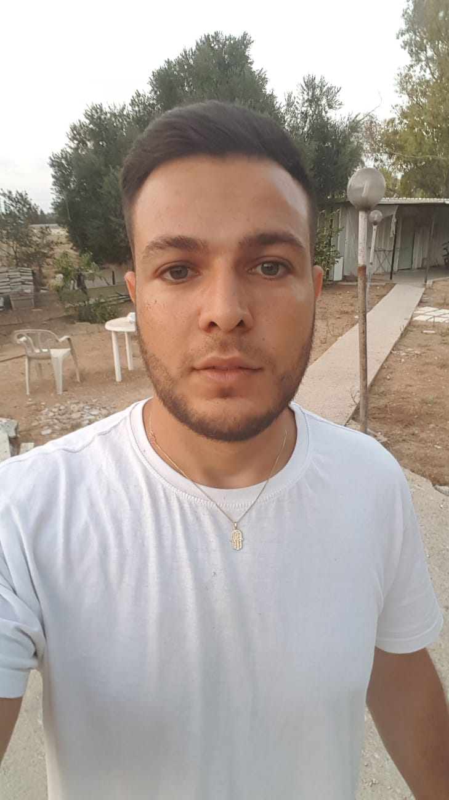
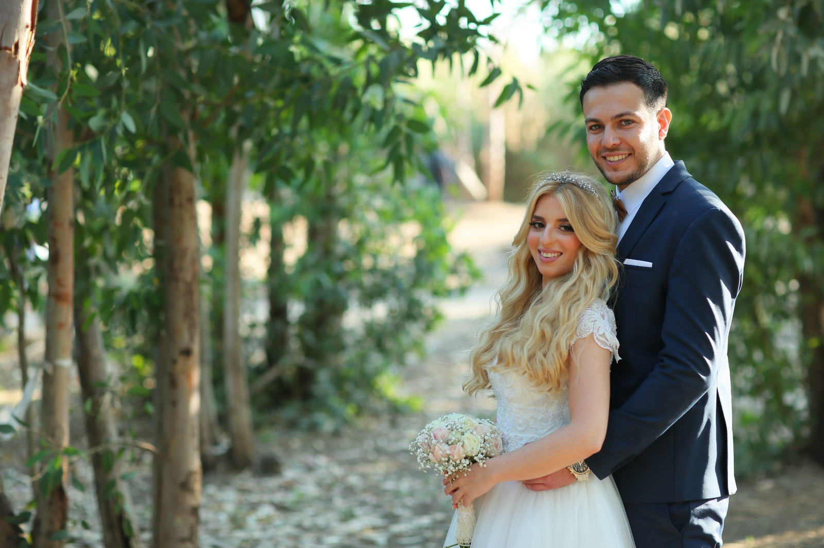
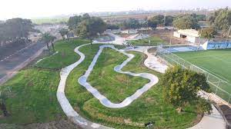
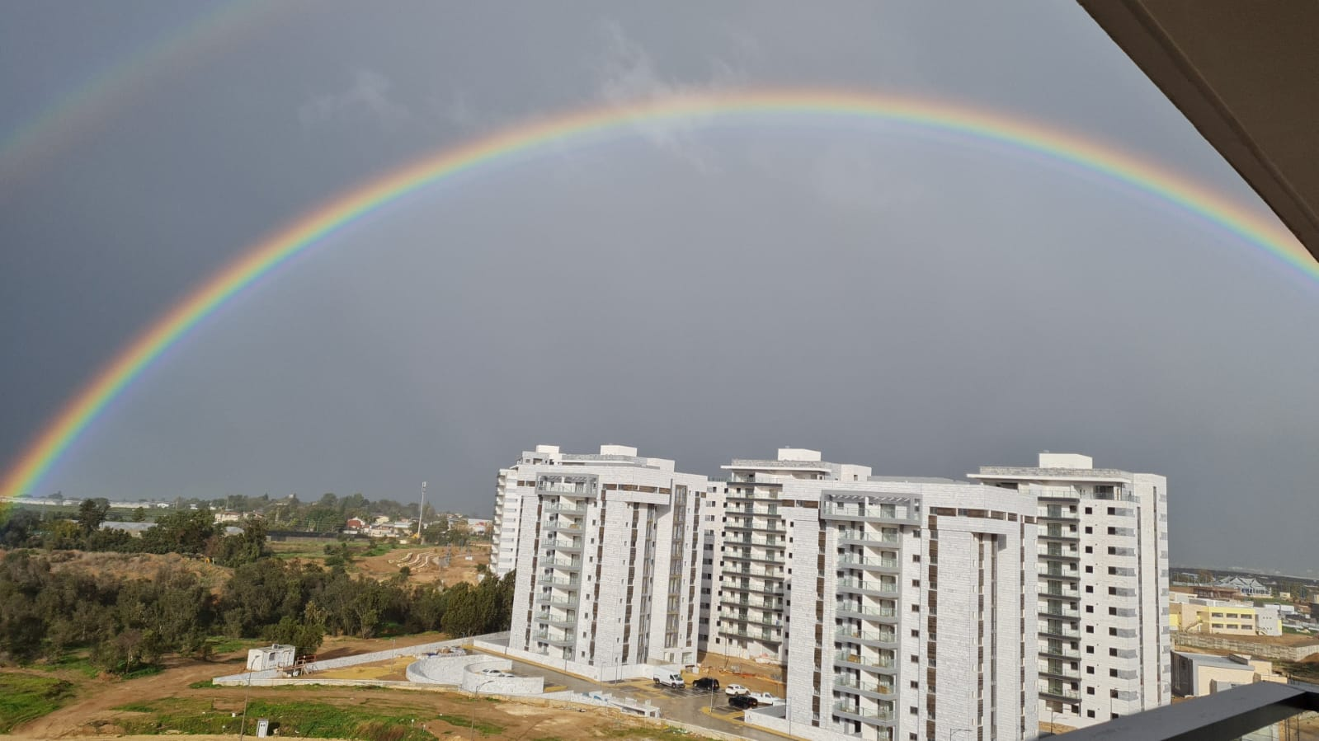
Who I am ? (Basic INFORMATION)
Ron Asis
Married
In the last year Married + 1
Lives in Netivot
Originally from Bat Hadar
Who I am ? | Experience | Portfolio of my work | Business Case | End

Slide 3
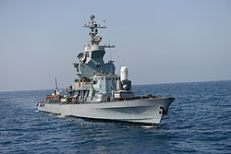
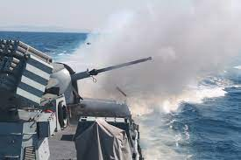
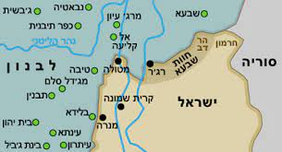

Who I am ? (Army)
Squadron 3 - a fleet of missile ships.
Fought in “Tzuk Eitan”.
I have been to neighboring countries.
Outstanding 3 times
Who I am ? | Experience | Portfolio of my work | Business Case | End

Slide 4



Who I am ? (Studies)
Ben-Gurion University.
Software engineering.
Average 85.
Outstanding final project
https://ronasi.wixsite.com/pr-reports
Who I am ? | Experience | Portfolio of my work | Business Case | End

Slide 5
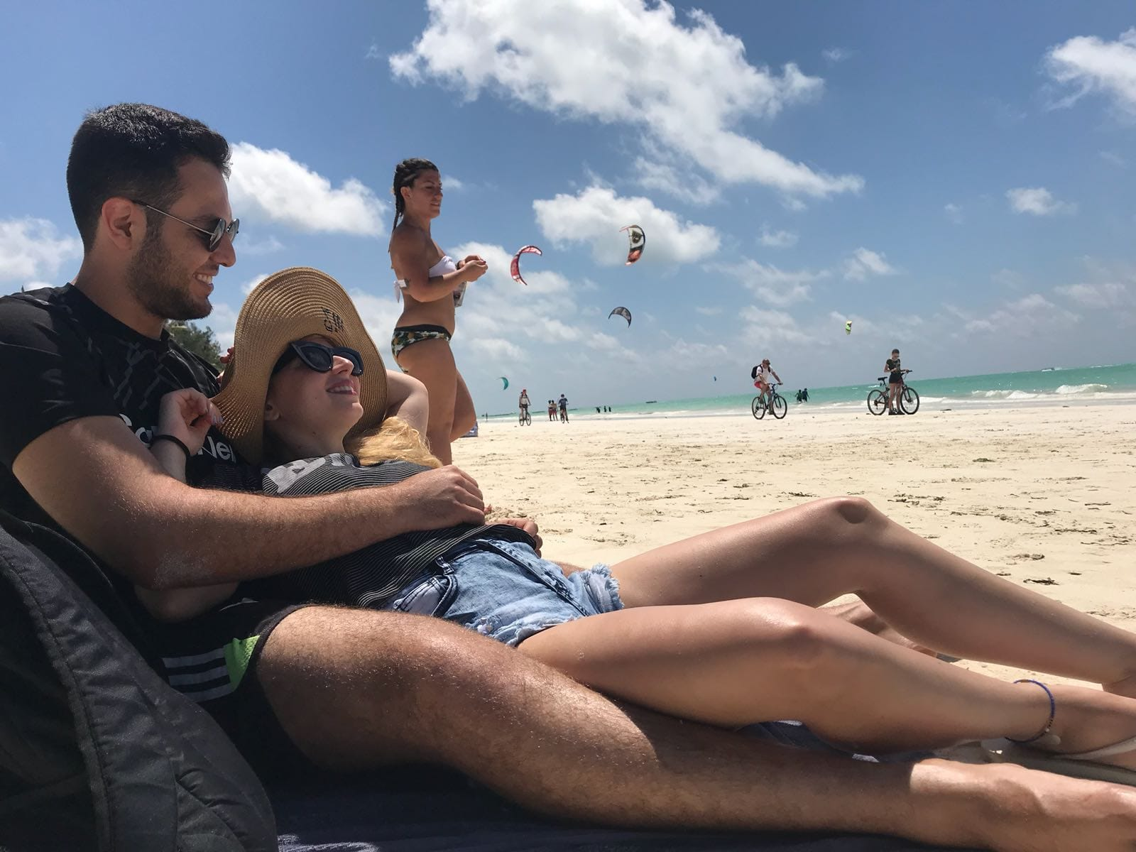
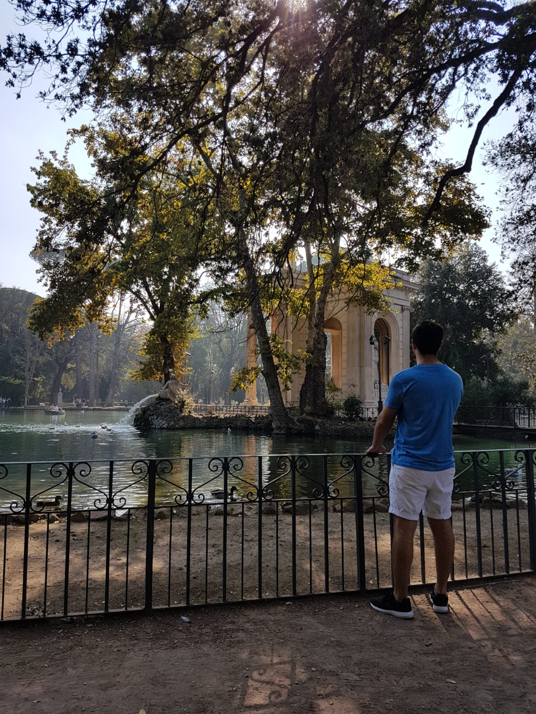
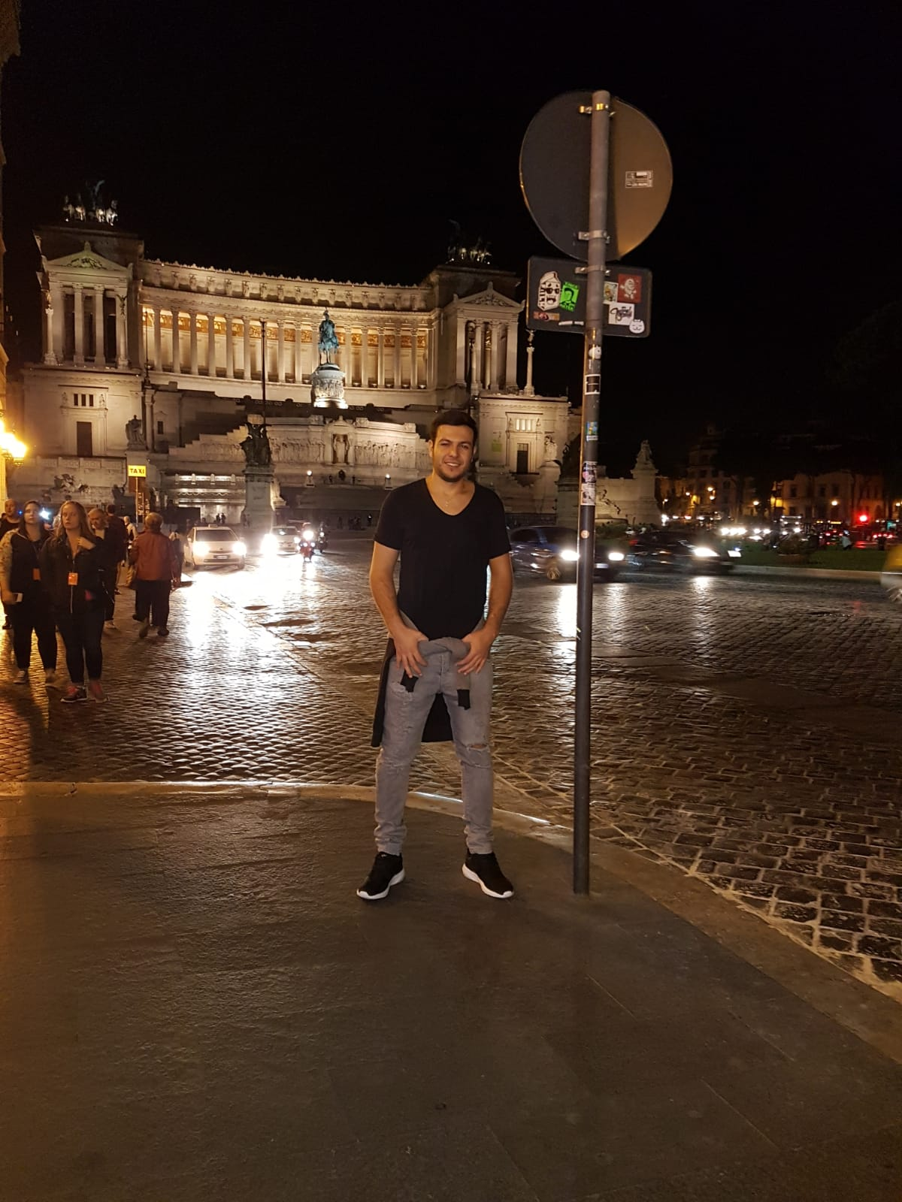
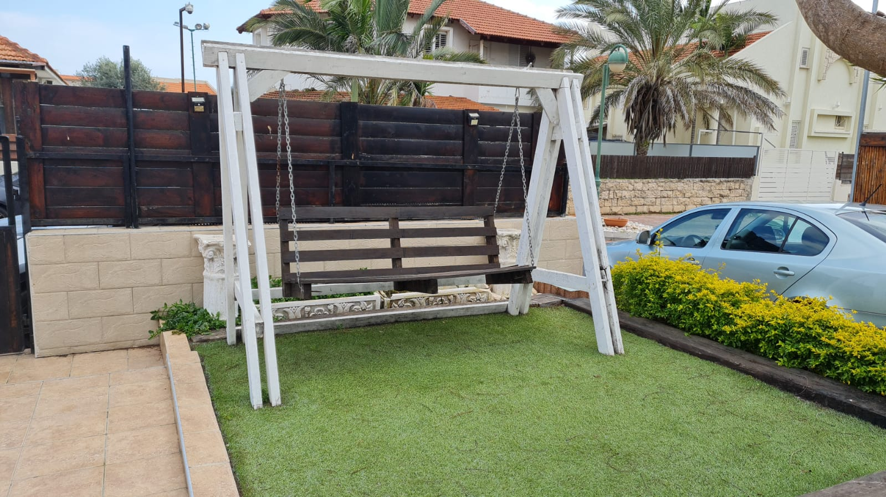
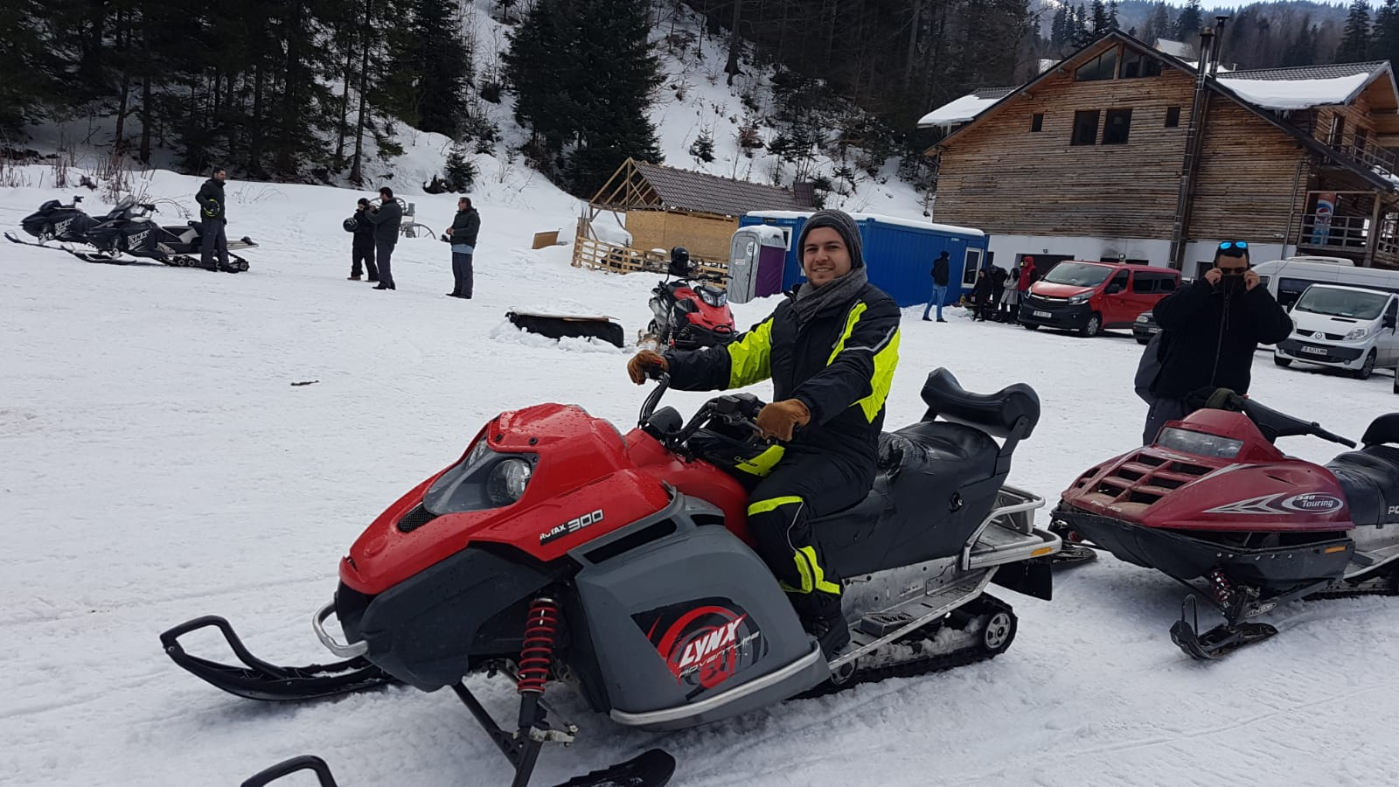
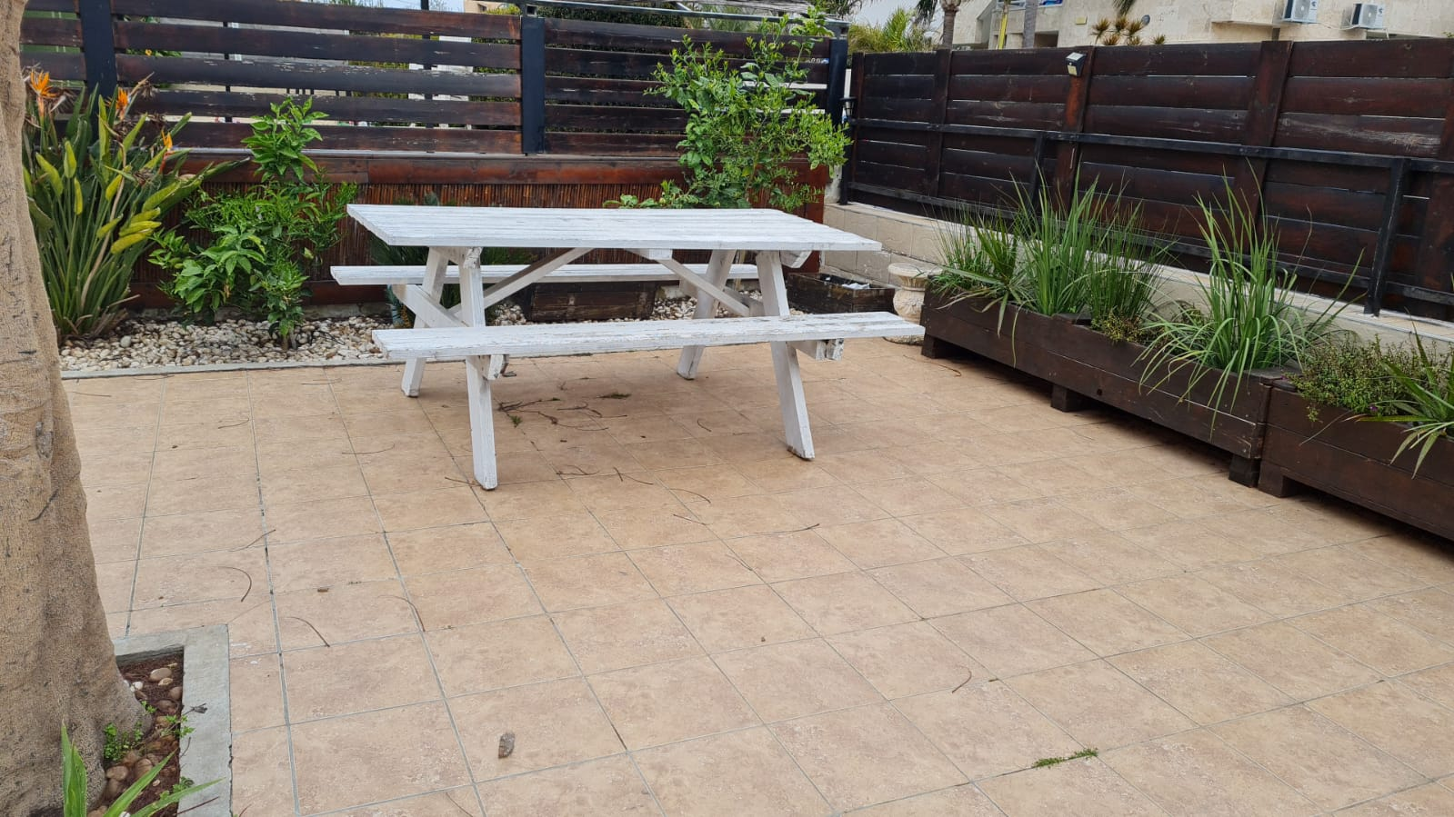
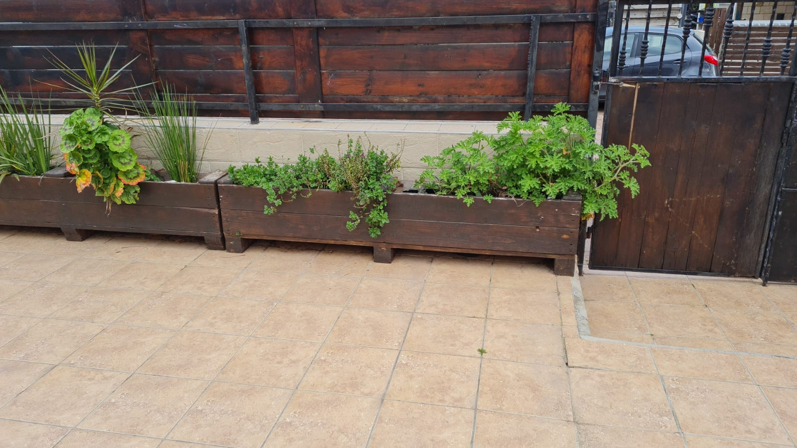
Who I am ? (Hobbies)
Like to build things out of wood.
Like to travel abroad.
Who I am ? | Experience | Portfolio of my work | Business Case | End

Slide 6
Experience (professional)
Java + Spring boot
Micro services
MariaDB
MongoDB
Rabbit
Junit 4, Junit 5
Lombok
A lot of library: Spring web, Spring Validation, Spring Security, Spring reactive, Spring data, Jasper,…
A lot of utils: CollectionUtils, …
Spring.factories.
Tools for manage project: Jenkins, bitbucket, github, Jira, confluence.
Design pattern
Backed side and UI side(Vadin, Angular, css, html).
From communications industry: Tosca, Muse, NfV
Who I am ? | Experience | Portfolio of my work | Business Case | End

Slide 7
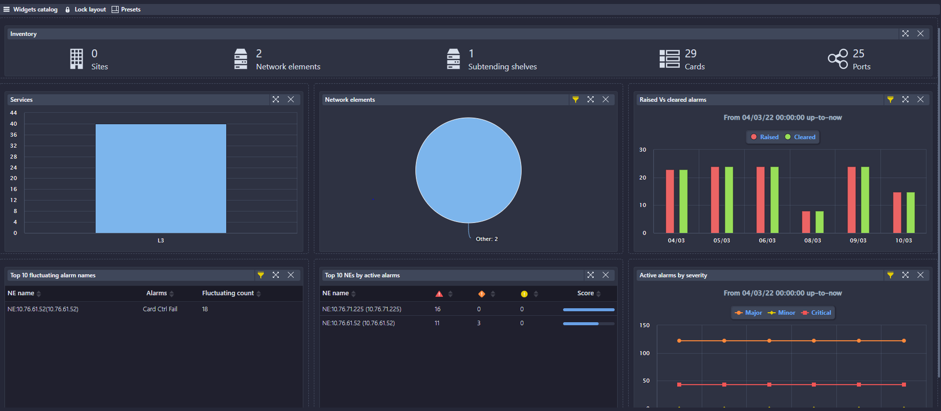
Portfolio of my work(Widgets 1)
Who I am ? | Experience | Portfolio of my work | Business Case | End

Slide 8
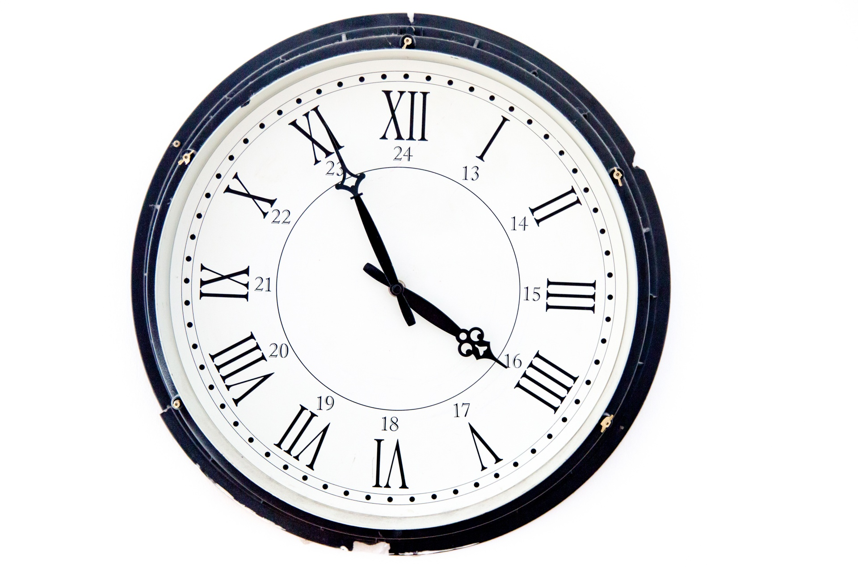
Portfolio of my work(Widgets 2)
Init task lib
Fault-mgr-ms
scheduler-service-ms
Report-manager-ms
tapi-mgr-ms
Rabbit-queue1
Rabbit-queue1
Report-manager-ms
network-mgr-ms
Report-manager-ms
Ui-muse-ms
...
Who I am ? | Experience | Portfolio of my work | Business Case | End

Slide 9
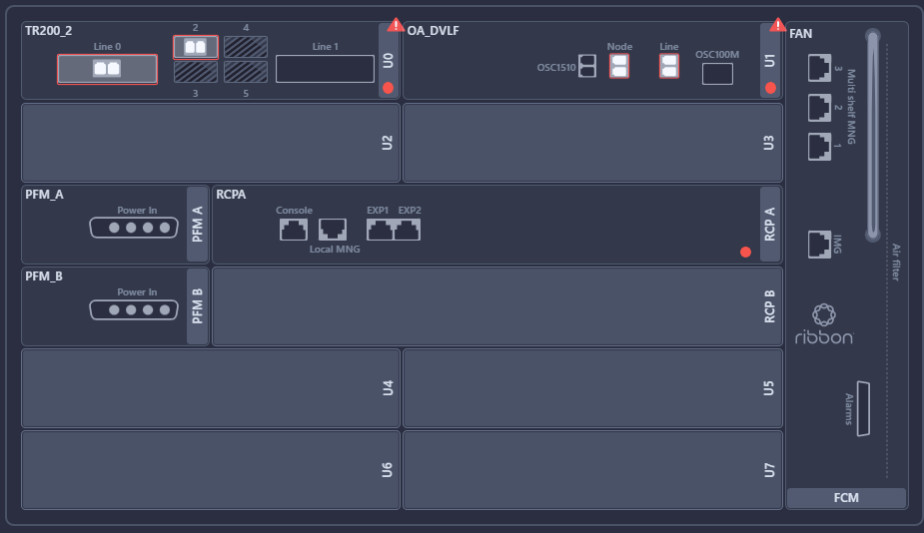
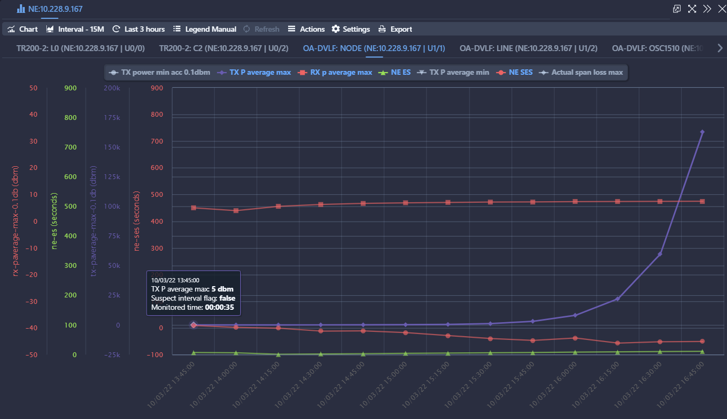
Portfolio of my work(PMS 1)
Who I am ? | Experience | Portfolio of my work | Business Case | End

Slide 10

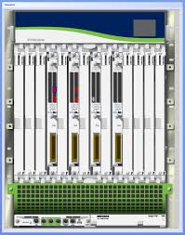
Portfolio of my work(PMS 2)
Mongo-service(27018)
Mongo-service(27017)
scheduler-service-ms
SSH-sbi-ms
Analytics-service-ms
Rabbit-queue1
network-mgr-ms
Who I am ? | Experience | Portfolio of my work | Business Case | End
Notes:
Eruka
Round robbin

Slide 11
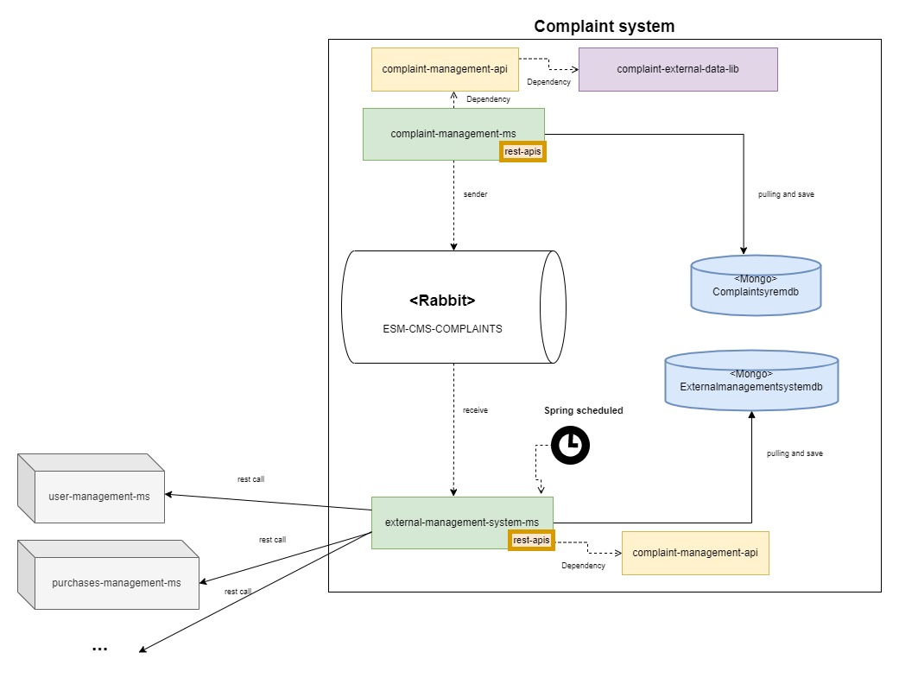
Business case-ARCH
Who I am ? | Experience | Portfolio of my work | Business Case | End

Slide 12
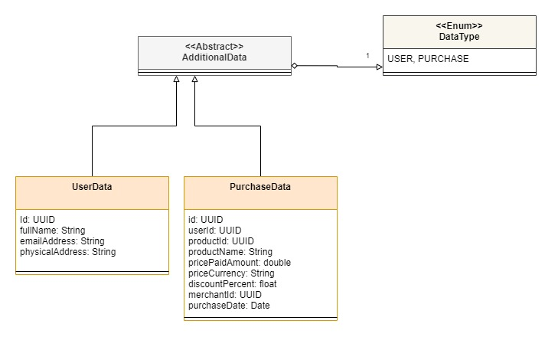
Business case- common Objects(SDK)
Who I am ? | Experience | Portfolio of my work | Business Case | End

Slide 13
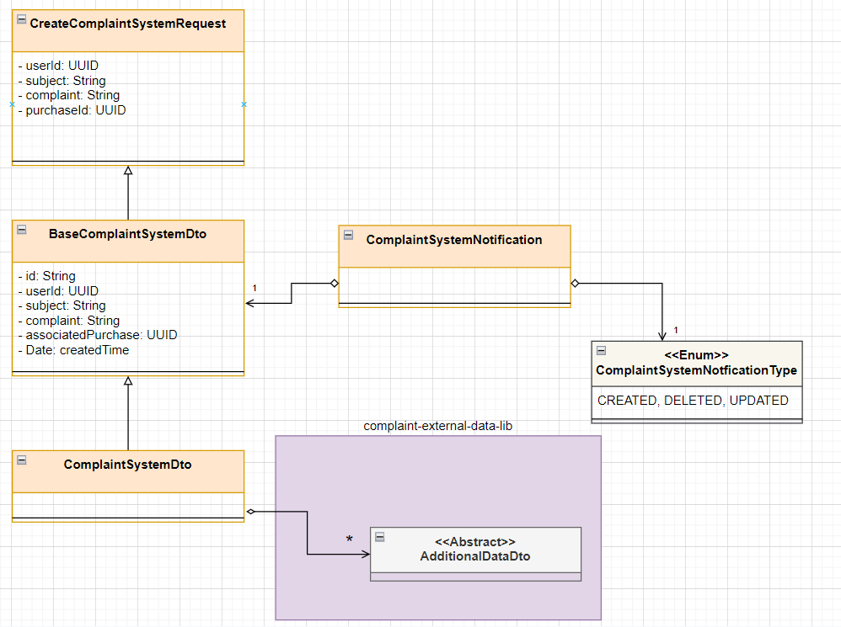
Business case- complaint management api
Who I am ? | Experience | Portfolio of my work | Business Case | End

Slide 14
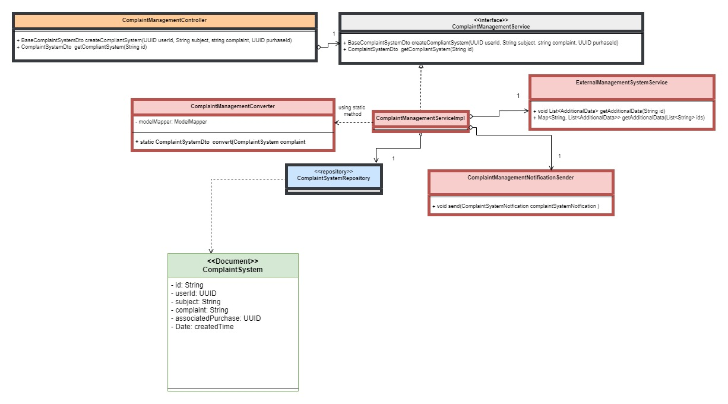
Business case- complaint management MS
Who I am ? | Experience | Portfolio of my work | Business Case | End

Slide 15
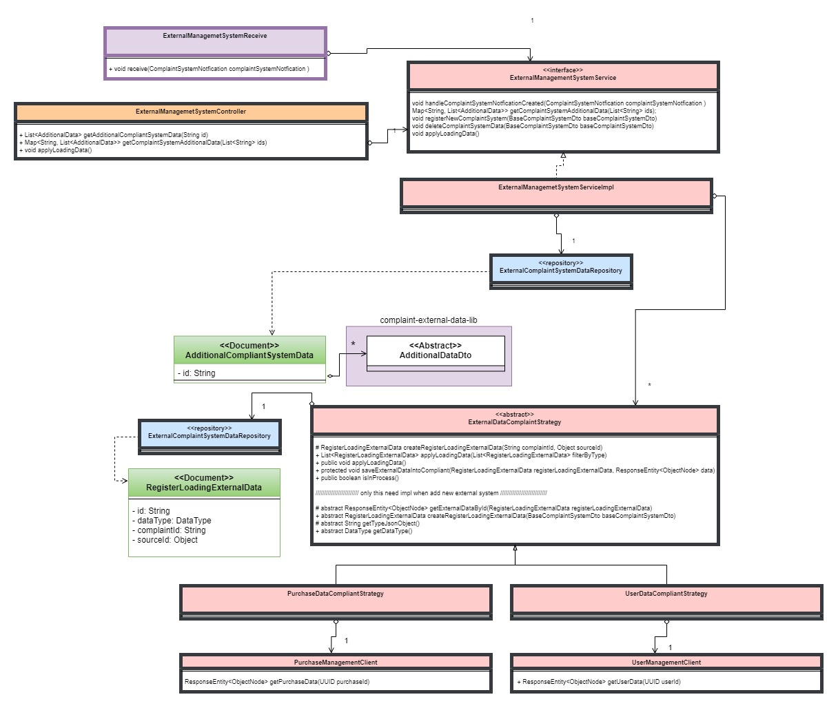
Business case- external management system ms
Who I am ? | Experience | Portfolio of my work | Business Case | End

Slide 16
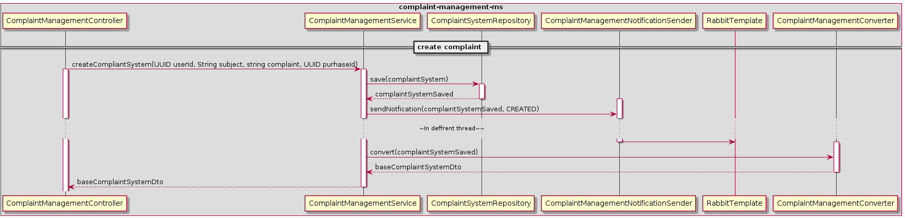
Requirement 1- creation part 1
Who I am ? | Experience | Portfolio of my work | Business Case | End

Slide 17
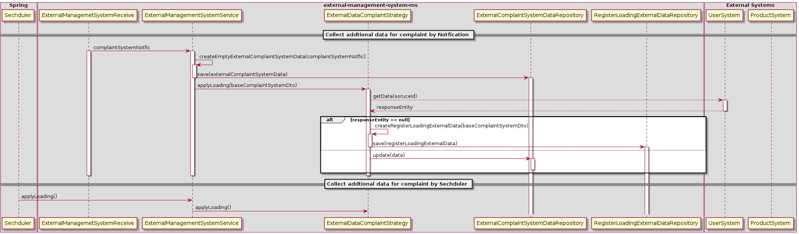
Requirement 1- creation part 2
Who I am ? | Experience | Portfolio of my work | Business Case | End

Slide 18
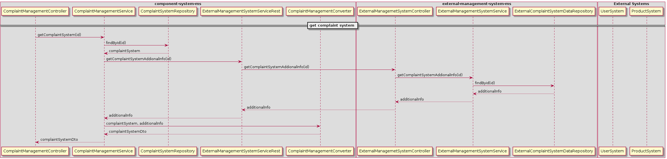
Requirement 2- get complaint
Who I am ? | Experience | Portfolio of my work | Business Case | End

Slide 19
Thanks !
Who I am ? | Experience | Portfolio of my work | Business Case | End

